Slide 1
Android Testing

Slide 2
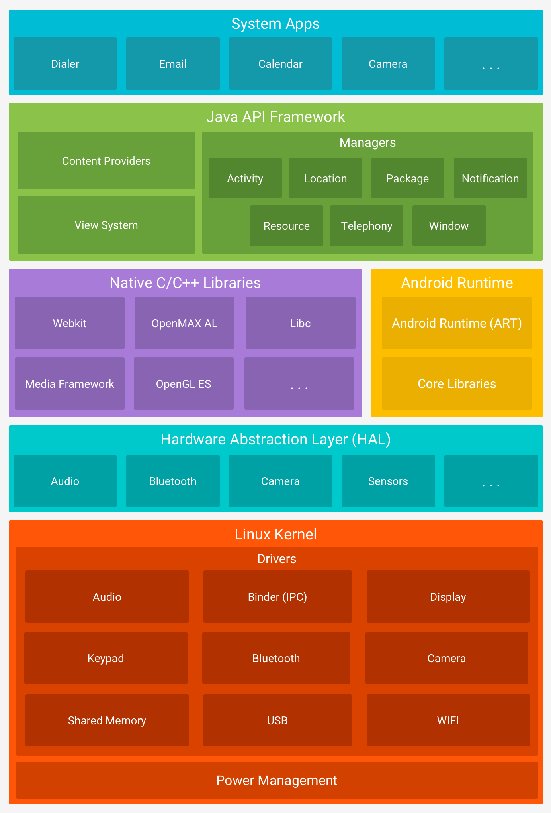

Slide 3
Mobile App Challenges
Short dev cycle, rapid changes, multiple form factors.
Native, Web and Hybrid apps.
Multiple devices and OS.
Non functional – Security and performance.
Backward compatibility.
Popular mobile web browsers.
Network.
Graphics, Video, Audio.
Memory usage.
Usability

Slide 4
Type of Mobile applications
Native app • Runs on device OS and firmware • Android, IOS
Web app • Browser app, web capable mobile devices • HTML, javascript
Hybrid app • Combination of Native and Web apps • Has cross platform compatibility

Slide 5
Multiple devices and OS Multiple Handsets
Multiple Handsets iPhone, Android Mobiles, Blackberry, Nokia, Windows Mobile
Multiple Platforms Android, IOS, Brew, J2ME, Windows Mobile and Symbian

Slide 6
Testing Approach
Installation/uninstallation
download and delete
Workflows and feature testing
Functional – specs and requirements
Data – different types of data •
Regression
Performance – quick and responsive
Localization – handle different languages

Slide 7
Android Apps
Managing the Activity lifecycle • Start activity • Pause and resume activity • Stopping and restarting • Recreating • Fragments • Nested activity • Layouts

Slide 8
Type of App testing
UI Testing – Color, menu, style
Performance and stress – under low resources
Usability testing
Certification compliance testing
Submission guidelines compliance testing
Interruption testing – voice calls, sms, low memory notification
Monkey testing
Low network/no network

Slide 9
Automation tools for Android based app
Selenium - Android driver
Appium
UI Automator
Monkey Runner
Robotium
Junit

